Slide 1
Introduction to Latent Diffusion Models
Yuxuan Xia
EECS 598: System for Generative AI

Slide 2




Diffusion Models… for AI Art
DALL-E 3
Midjourney

Slide 3
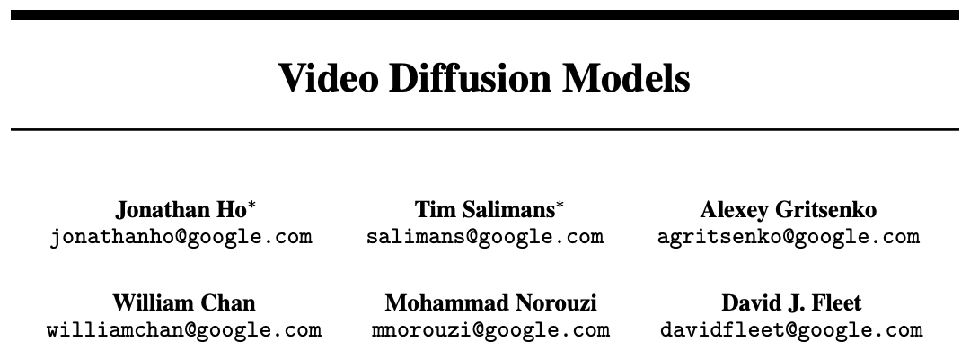
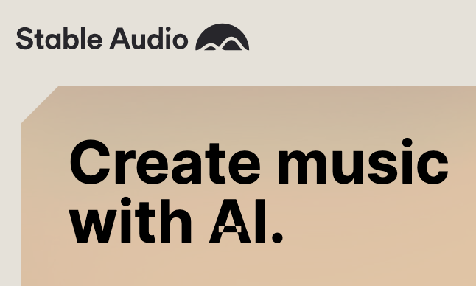
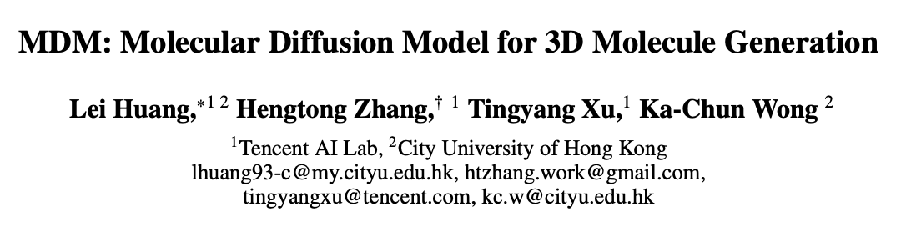
Diffusion models are more than AI art!

Slide 4
What is Diffusion?

Slide 5
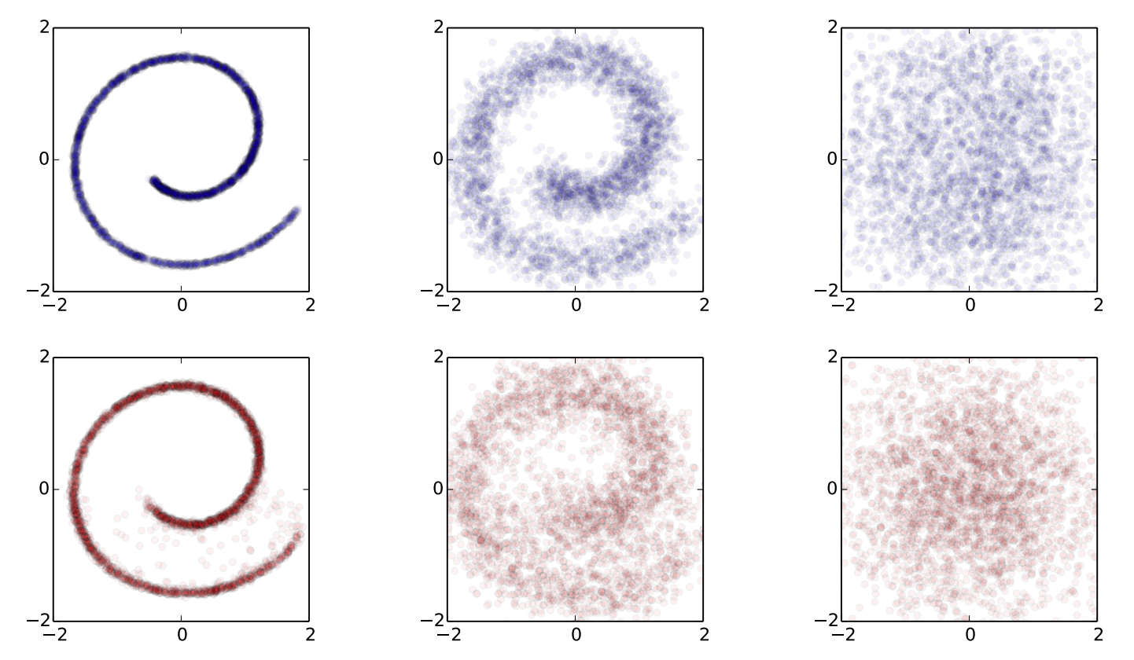
Why is it called Diffusion?
Diffusion process forward in time
Can a model do this?

Slide 6
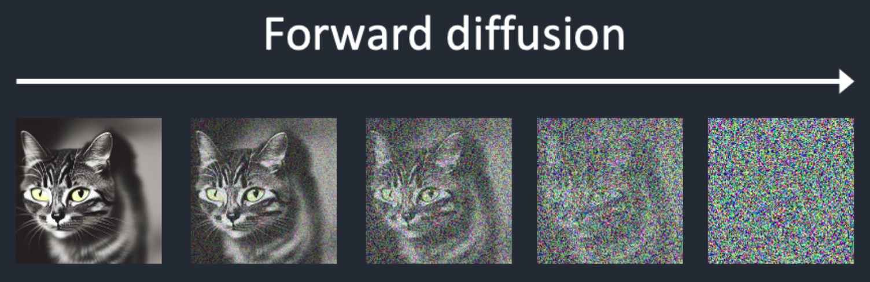
Why is it called Diffusion?
Can a model do this?

Slide 7
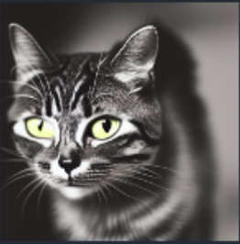

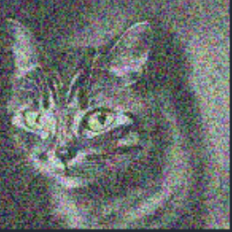
Removing noise from images
+
=
Given
=
-
Want to predict

Slide 8
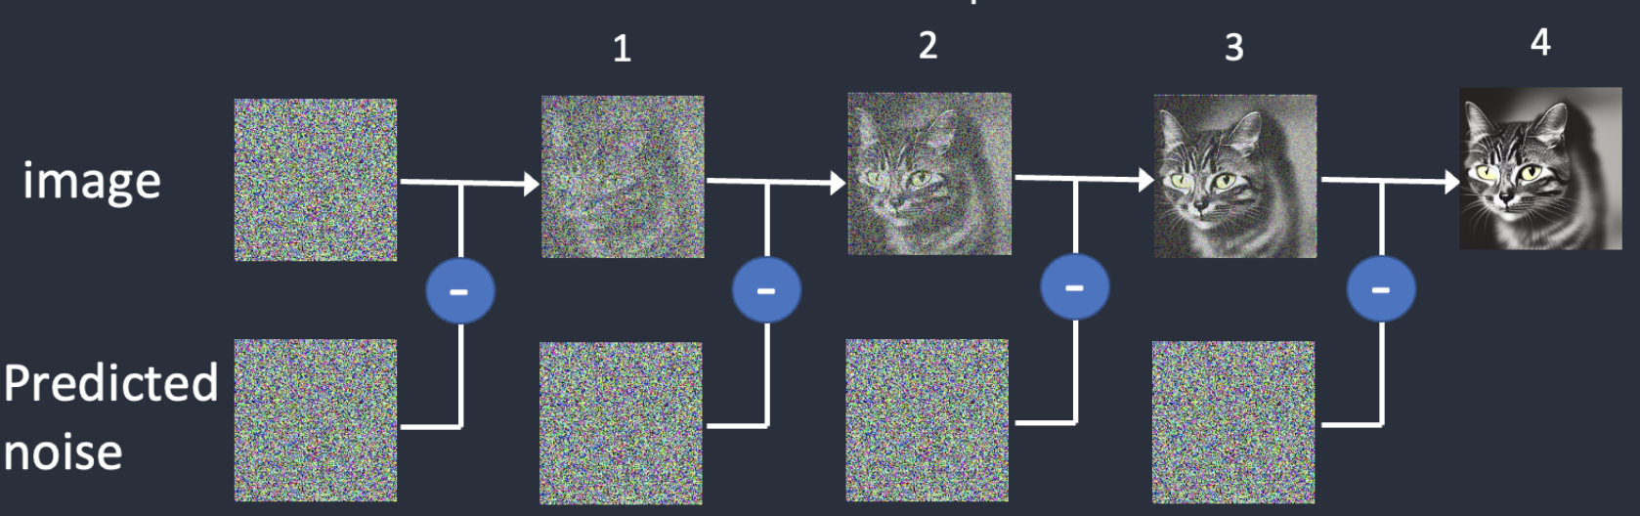
Removing noise from images

Slide 9
Predicting the noise - UNet
UNet
Noise level: 2

Slide 10
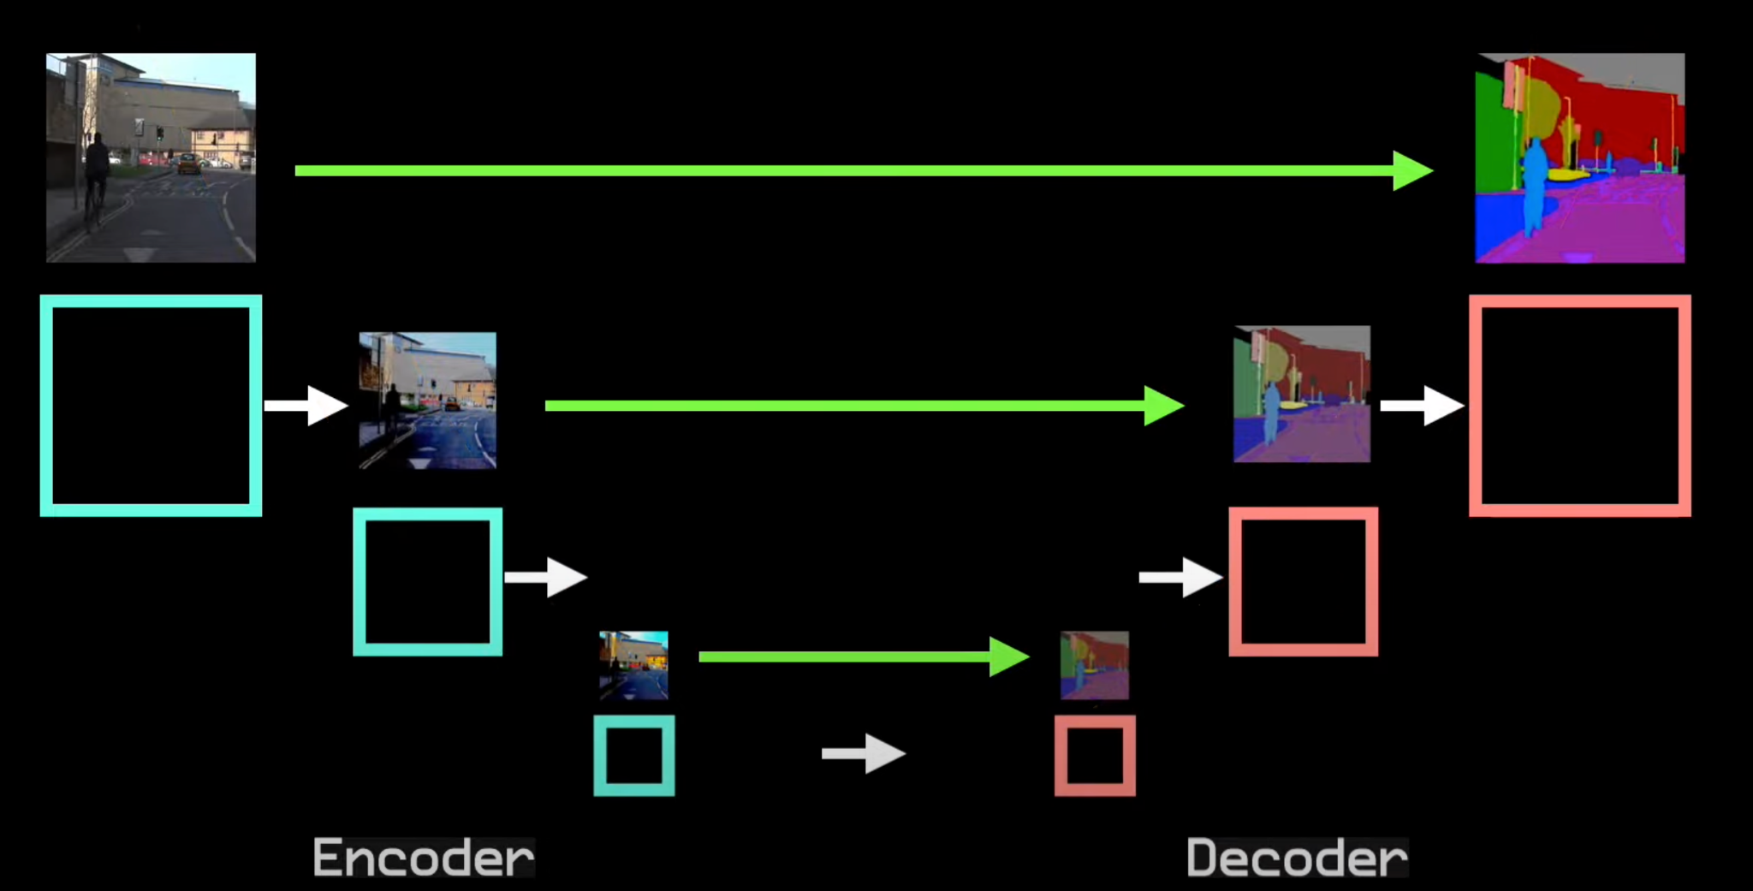
Predicting the noise - UNet
Conv
Max pooling
Up-Conv

Slide 11
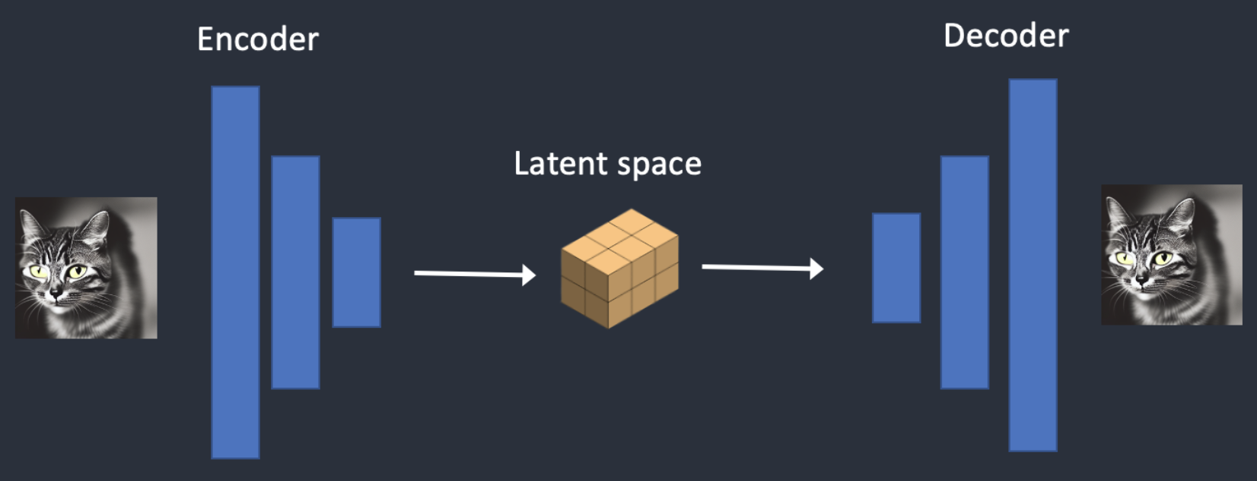
The Latent Space and VAE
Pixel space dimension: 512 x 512 x 3 = 786432… Too big!
Idea: Reduce the dimension of possible space for denoising
Latent dimension for Stable Diffusion:
4 x 64 x 64 = 16384
48 times smaller!

Slide 12
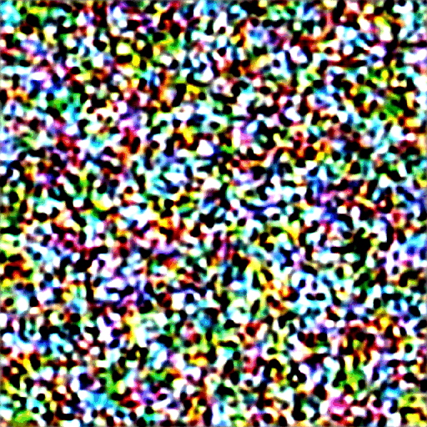
Denoising example in latent space

Slide 13
Conditioning the Diffusion Process

Slide 14



Conditioning: Text-to-image
To incorporate text information, we first need to embed the prompt text.

Slide 15
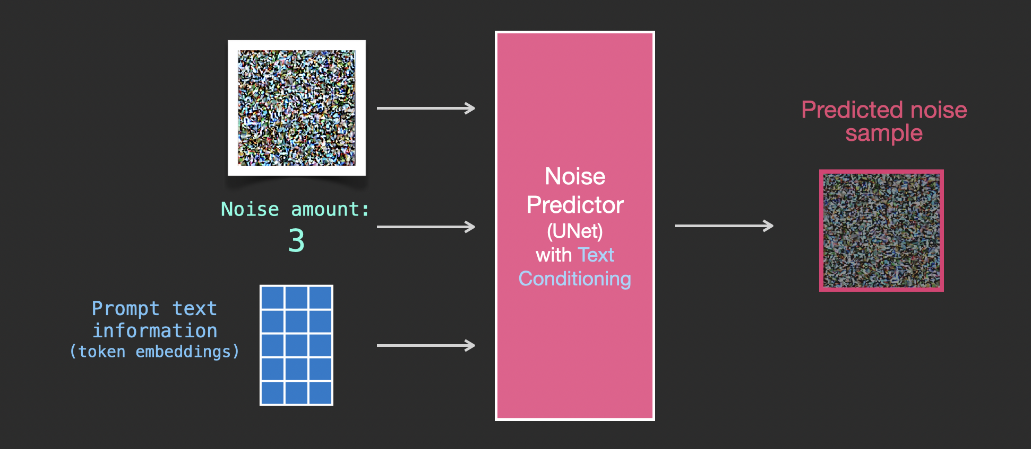
Conditioning: Text-to-image

Slide 16
Conditioning: Text-to-image
Conv
Max pooling
Up-Conv

Slide 17
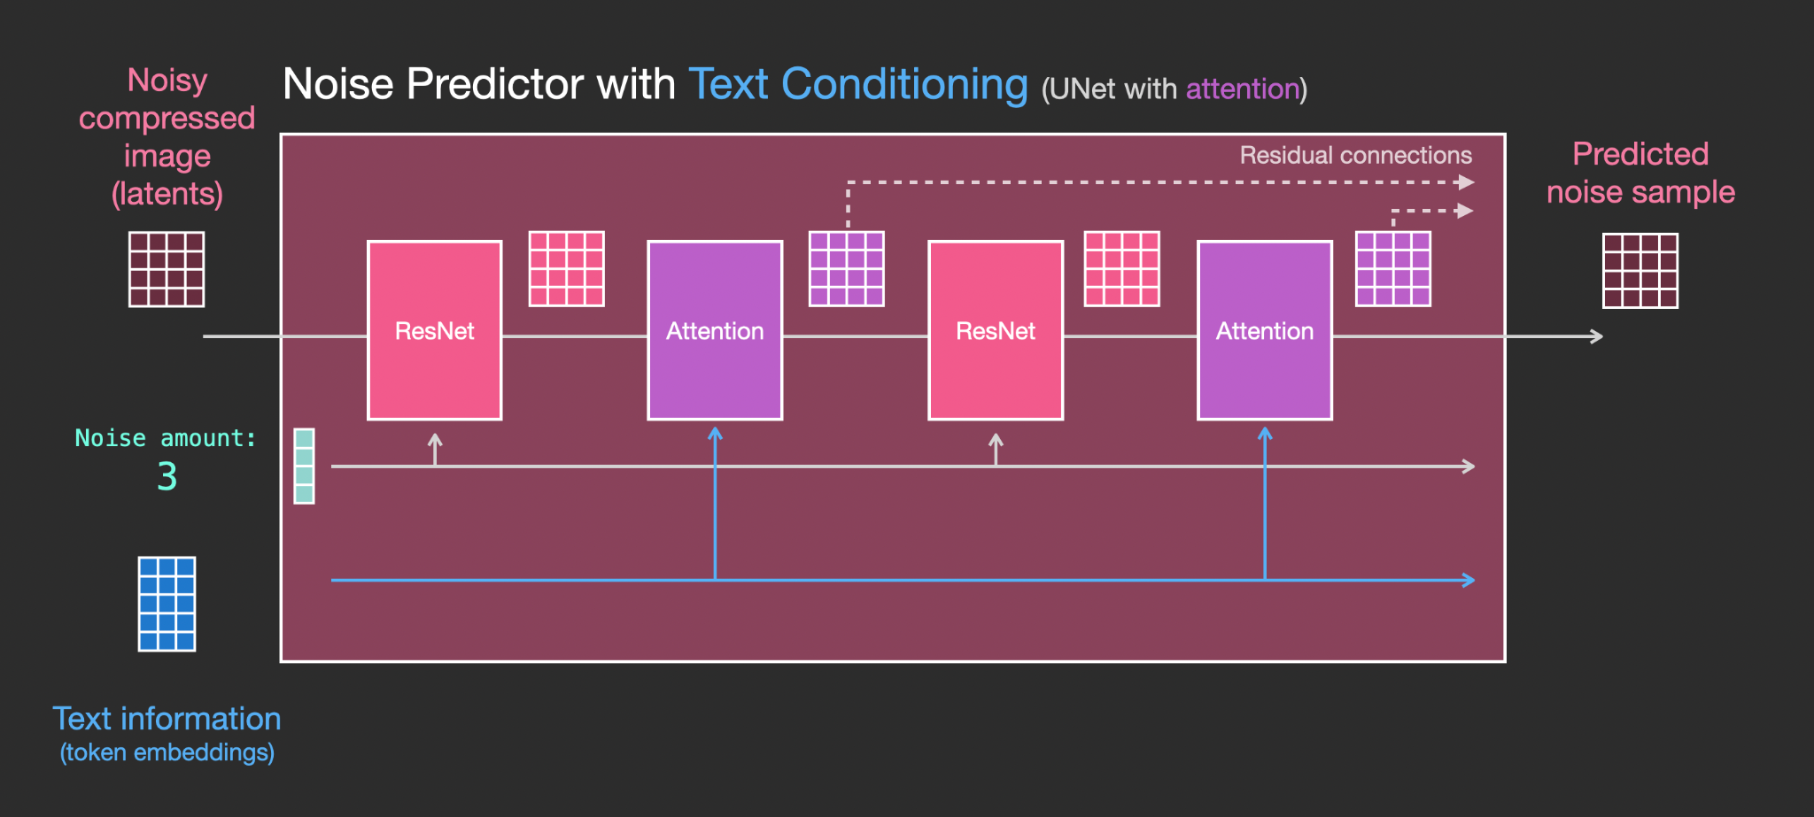
Conditioning: Text-to-image

Slide 18
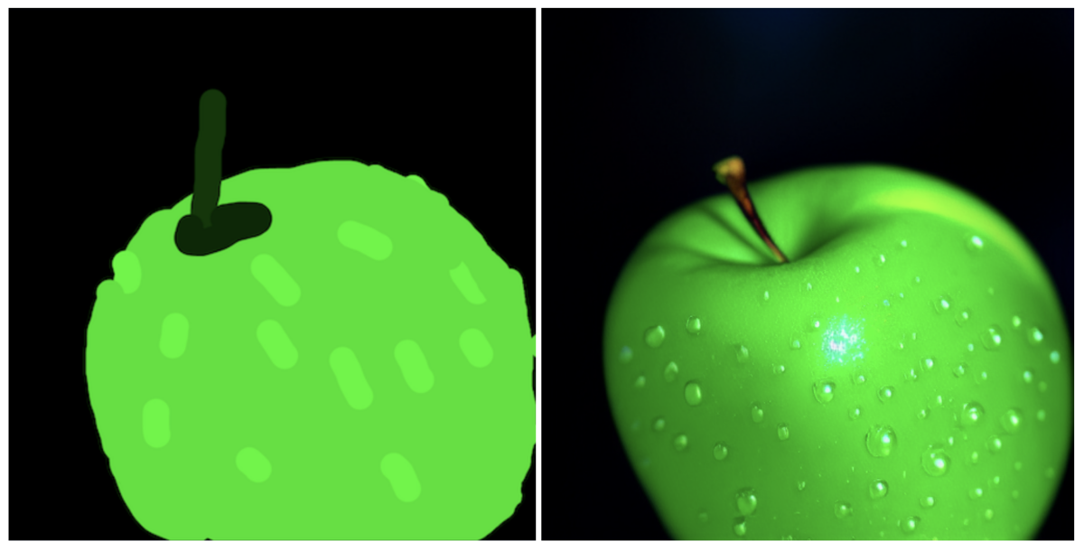
Conditioning: Image-to-image
An Image-to-image model:
Turns current image into one with similar composition
Generated image resembles the training set
Can in addition take in a text prompt

Slide 19
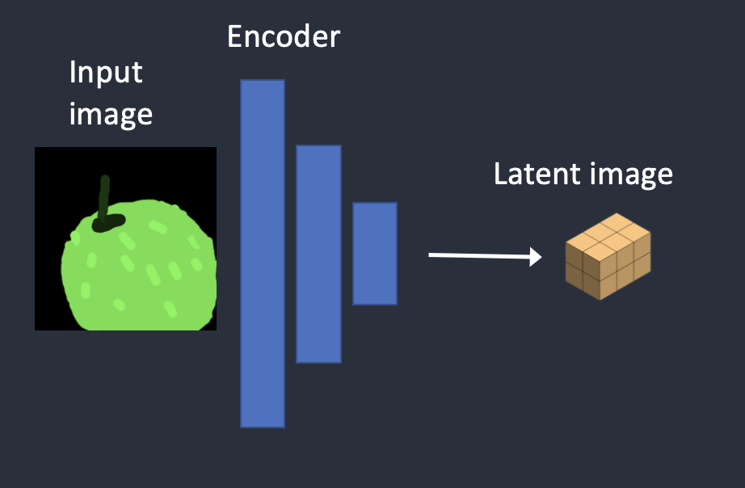
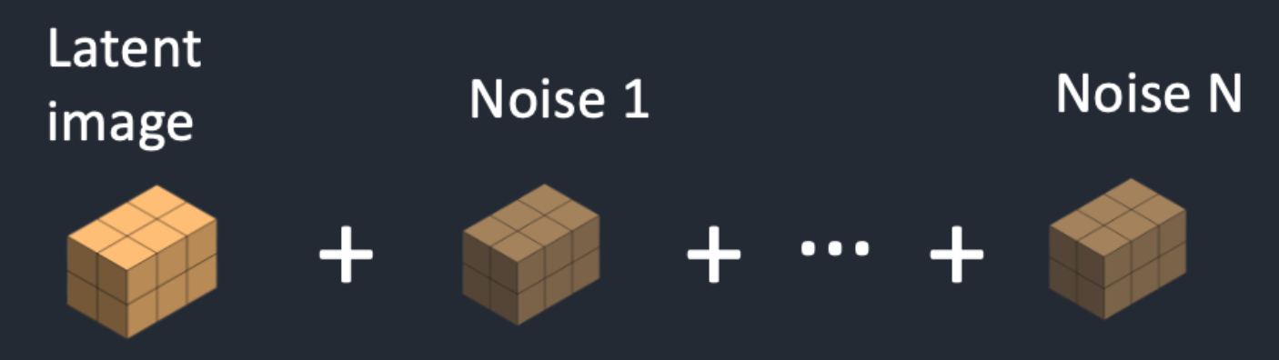
Conditioning: Image-to-image
Instead of using random noise to begin with, use a “noised” version of given image
The semantic information of original image is hidden behind the noise

Slide 20
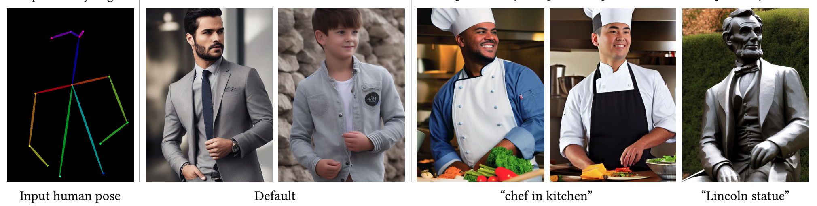
Conditioning: ControlNet
Can we use other types of conditioning, in addition to image and text?

Slide 21
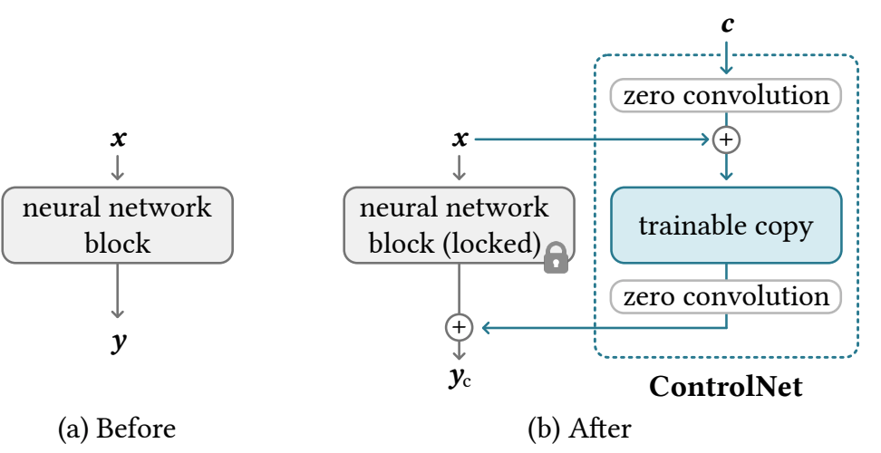
Conditioning: ControlNet
Train a “copy” of the original block, while taking the condition as input
The output of ControlNet is fed back to the original model

Slide 22
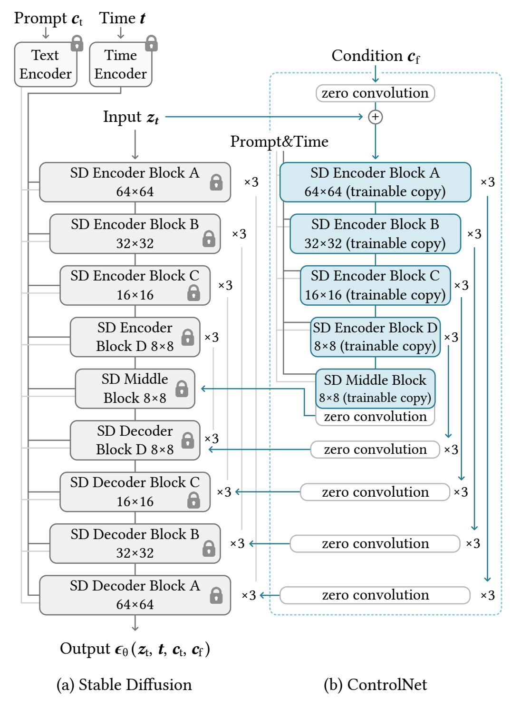
Conditioning: ControlNet
From the system/computation viewpoint:
During inference, each UNet iteration takes ~2x computation with ControlNet addition
The extra computation is similar to the original, and can be parallelized
For training, roughly the same computation as training a UNet model
For each type of condition, need a different ControlNet model

Slide 23
Stable Diffusion as a whole

Slide 24
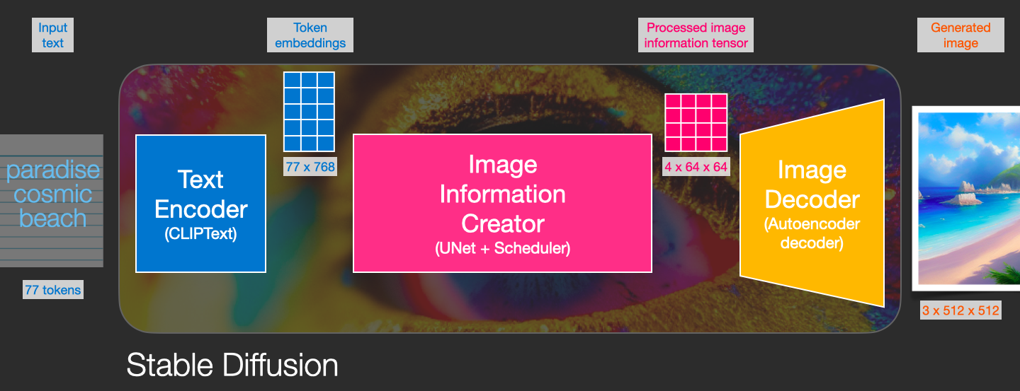
Putting things together

Slide 25
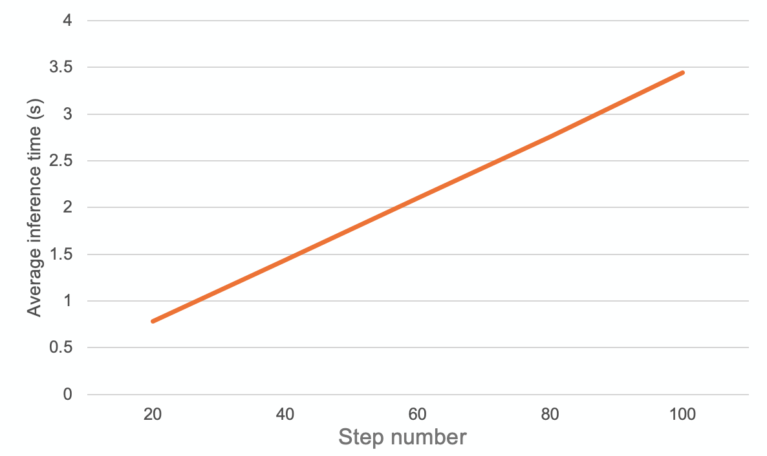
Characteristics of Stable Diffusion
The different components are relatively independent
The main model = UNet
On inference, most of the time is spent on UNet loop
Compared to LLM, much smaller model

Slide 26



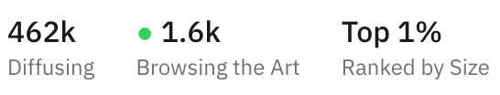
Characteristics of Diffusion Workloads
Stable Diffusion 1.5: UNet+VAE - 860M, CLIP encoder - 123M Total size: ~4GB ControlNet: Additional 700M
Stable Diffusion XL: UNet+VAE - 2.6B, CLIP encoder - 700M Total size: ~12GB
GPT-3: 175B Total parameters, ~800GB Total size
Llama2-7B: 7B Total parameters, ~30GB Total size
It’s much more feasible to run Diffusion models locally

Slide 27
Problems and the Future
AI side:
Ethical and copyright problems
Bad performance on details
How to get better understanding of complex prompts
System side:
The divided landscape between local models and large serving systems
Generally, a lack of research done: not nearly as much as LLM system papers

Slide 28
Thank you!
Q&A
Images taken from:
https://stable-diffusion-art.com/how-stable-diffusion-work/
https://jalammar.github.io/illustrated-stable-diffusion/
https://huggingface.co/blog/controlnet
Special thanks to Jae-Won for the Michelangelo quote

